Slide 1



Have you completed your pre-use inspection?

Slide 2

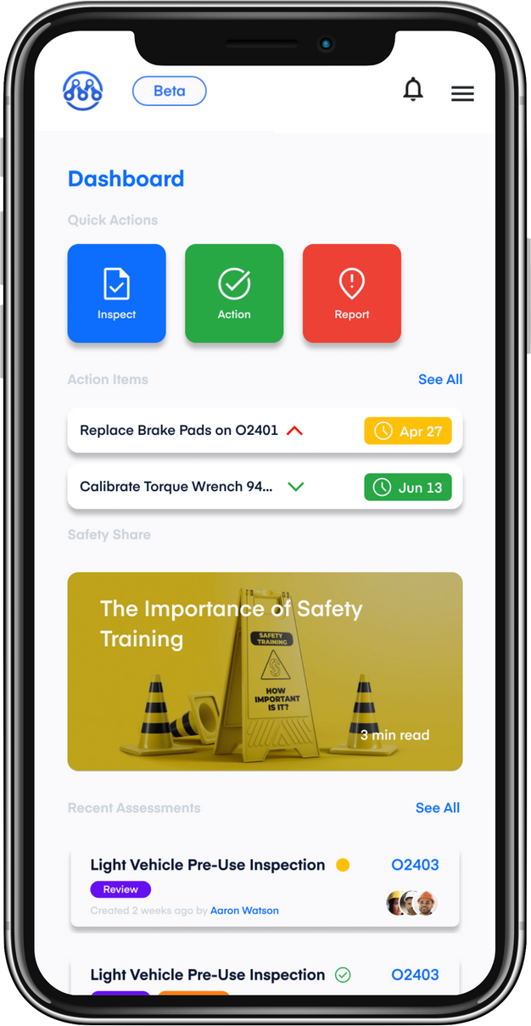

See something?
Say Something.
Good or bad, observation cards only take 30 seconds to complete.

Slide 3
Good or bad, let us know.
Observation Cards take less than
30 seconds
to complete.

Slide 4


WE CARE ABOUT
YOU
WORK SAFE TODAY
START EVERY TASK WITH A FLRA

Slide 5

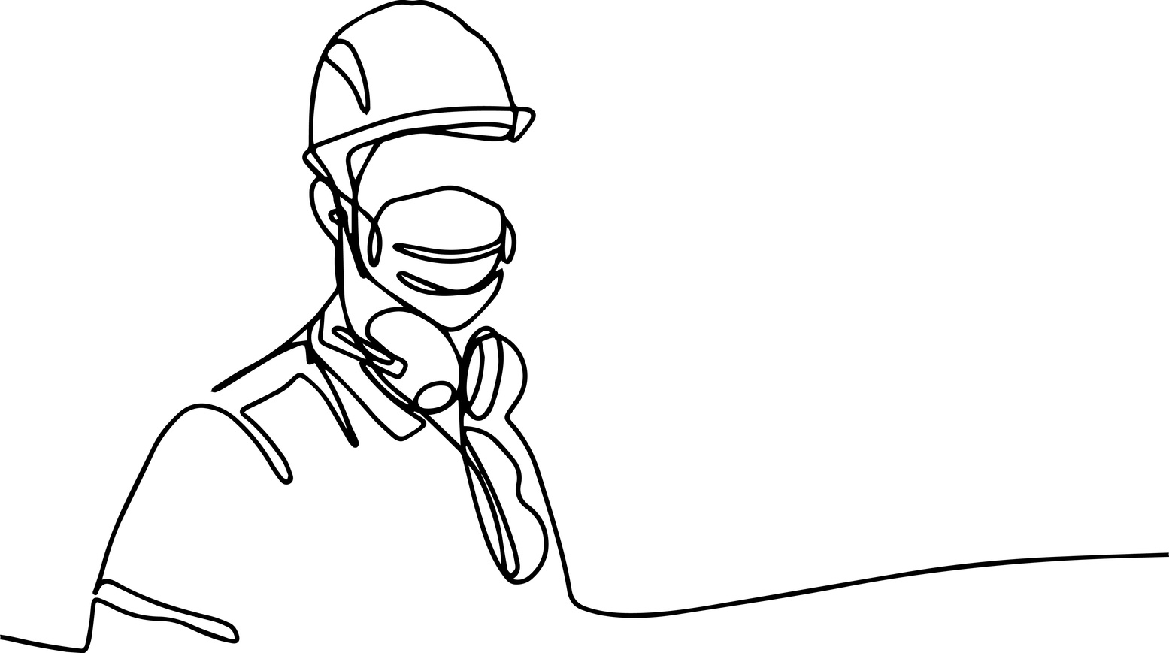

Slide 6

DAILY, AT THE START OF THE SHIFT
Equipment inspections

Slide 7


Before you hit the road
your pre-use inspection

Slide 8
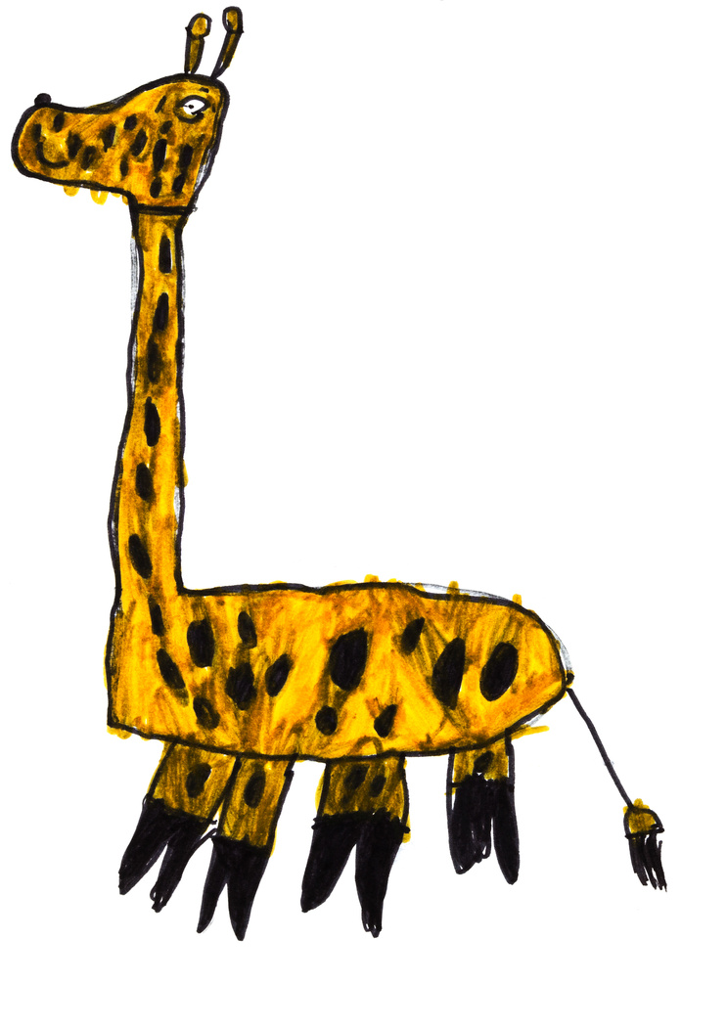

Why do you work safe?
My kids
Take 5 minutes at the start of your job to consider safety. It could save your life.

Slide 9

Why do you work safe?
My family
Take 5 minutes at the start of your job to consider safety with a FLRA. IT COULD SAVE YOUR LIFE

Slide 10
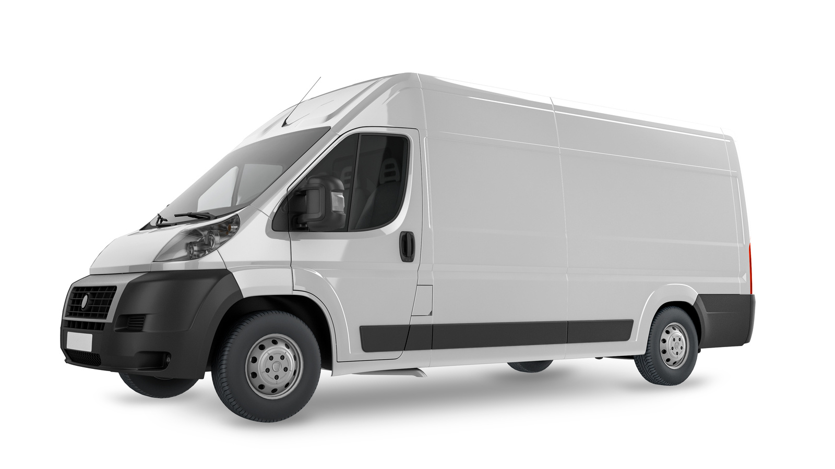
Take 5 minutes at the start of your job to consider safety. It could save your life.
Field Level Risk Assessment (FLRA)
Equipment Inspections

Slide 11
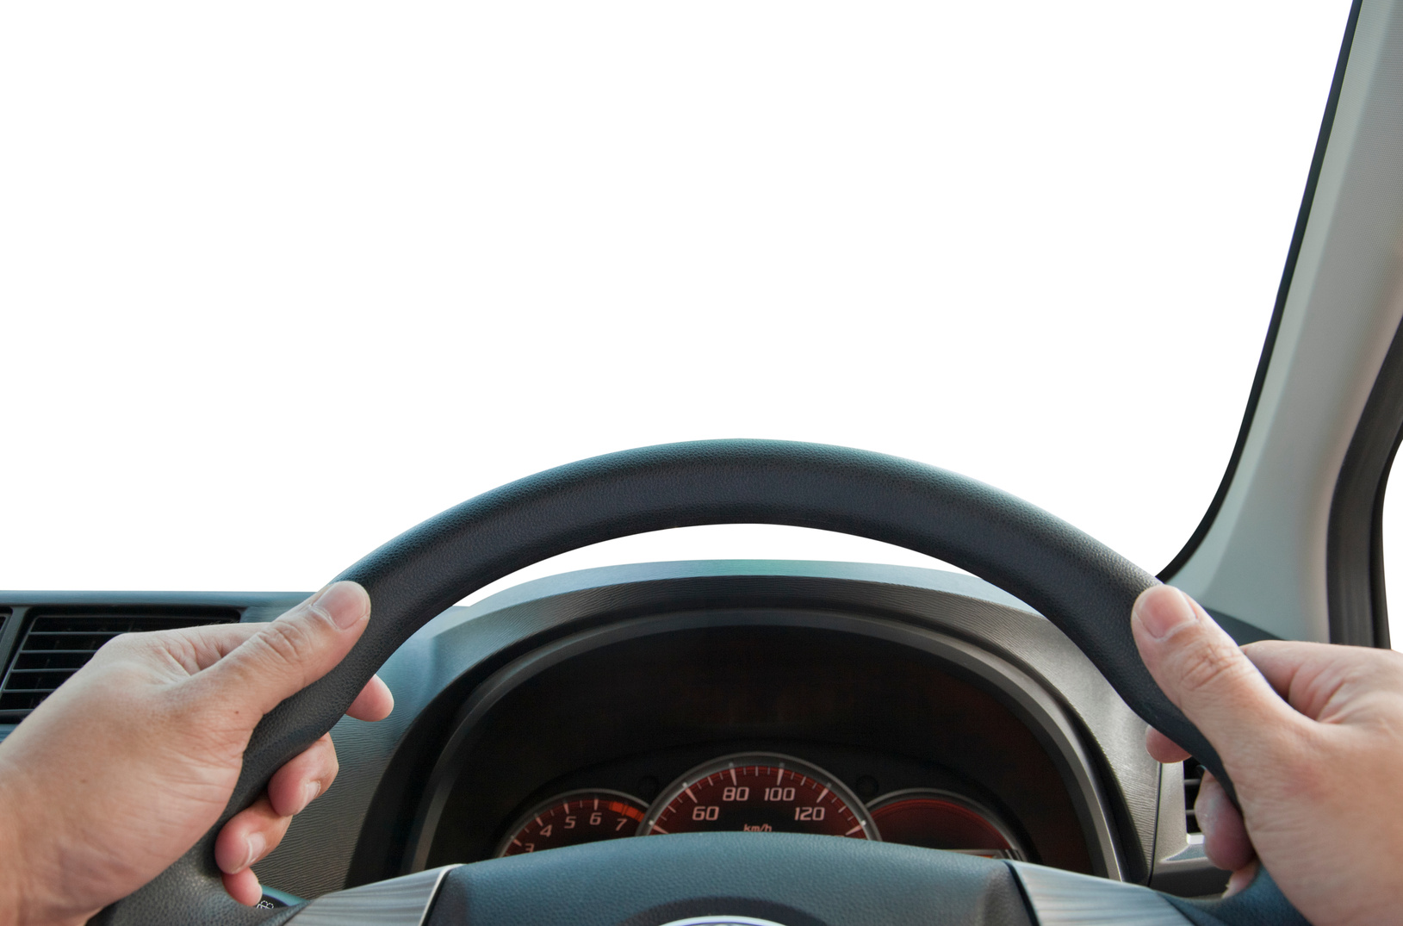
Pre-use inspections stop common vehicle incidents in their tracks

